Slide 1



Supply chain
Insights
Instructor : Wael Gomaa Team(2)
July 2026

Slide 2
Team Members
Mariam Alaa
Marwan Ayman
Alaa Hassan
Kyrillos Nassar
Sara Tawfik

Slide 3

Project Overview
This project presents a supply chain dashboard that provides a comprehensive view of key operations, including inventory management, order fulfillment, transportation, and logistics performance.
Through interactive visualizations, the dashboard simplifies complex data, enabling users to quickly assess performance, identify trends, and detect inefficiencies.
The goal is to transform operational data into clear, actionable insights that support better analysis and more informed decision-making across the supply chain.

Slide 4

Data Source
This study is based on data obtained from the Digital Egypt Pioneers Initiative (DEPI) platform, where the dataset was provided for educational and training purposes. The data is well-structured and reliable, making it suitable for analysis and interpretation. In addition, Data Quality Control (QC) procedures were applied to ensure the accuracy, consistency, and completeness of the data before conducting the analysis.

Slide 5
Problem Statement
Challenges:
Companies often face challenges in:
Identifying profitable vs underperforming products Evaluating supplier reliability and cost efficiency Managing inventory risks (overstock / stockouts) Optimizing shipping time and costs
Understanding customer behavior and market trends
Cons:
Lack of integrated insights leads to: Poor decision-making Increased operational costs Missed revenue opportunities

Slide 6
Questions
Product Performance & Profitability
Supplier & Logistics Efficiency
Which products generate the highest profit? Which products have high sales but low margins? What categories are driving overall revenue?
Which suppliers are most reliable?
Which suppliers have the highest delays or costs? How does supplier performance affect operations?
Shipping & Transportation Analysis
What are the average shipping times? Which regions experience the most delays?
How do shipping costs vary across methods?
Inventory & Stock Management Which products are at risk of stockout? Which items are overstocked?
How efficient is inventory turnover?
Customer Demographics & Sales Trends
Who are our main customer segments? Which regions generate the most sales?
What are the key purchasing trends over time?

Slide 7



Analysis Steps
1) Data Collection
3) Data Modeling
5) Report
2) Data Cleaning
4) DAX
6) Dashboard

Slide 8
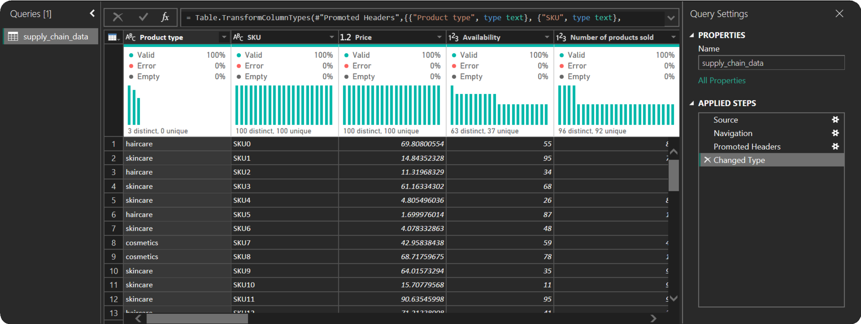
Data Cleaning
Before

Slide 9
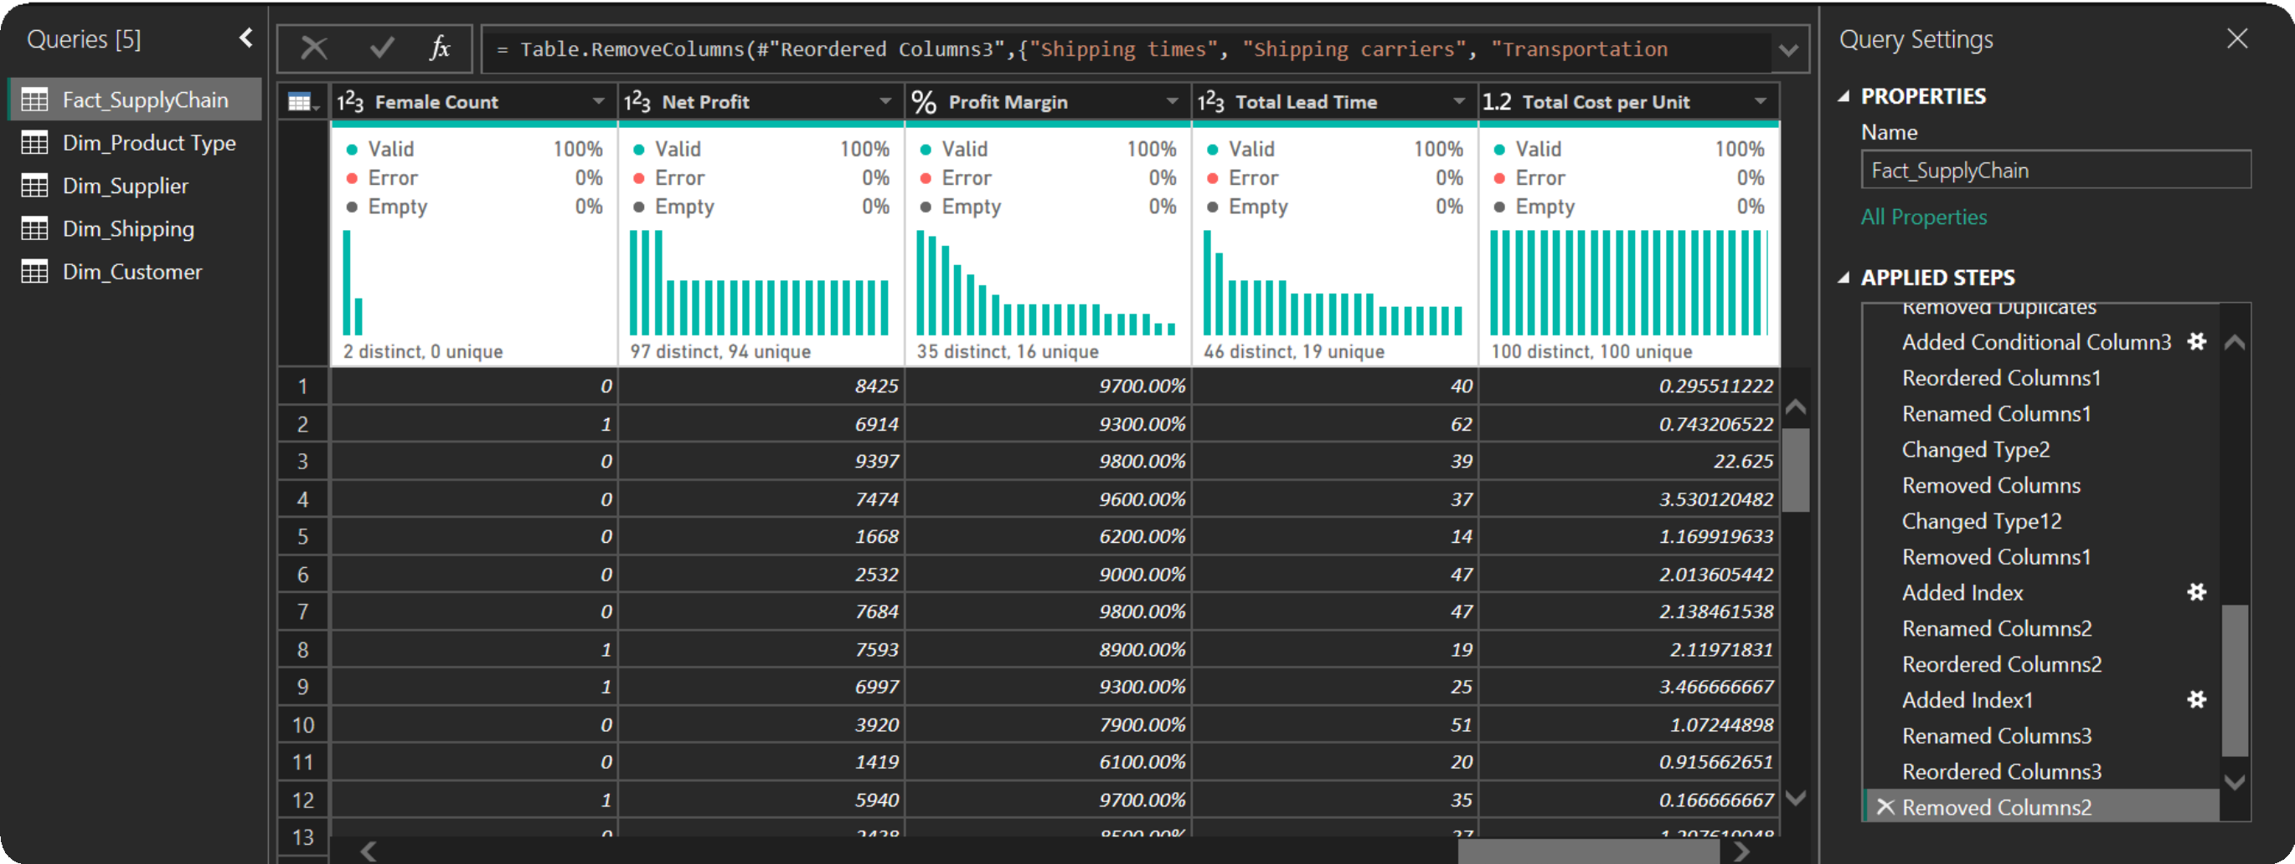
Data Cleaning
After

Slide 10
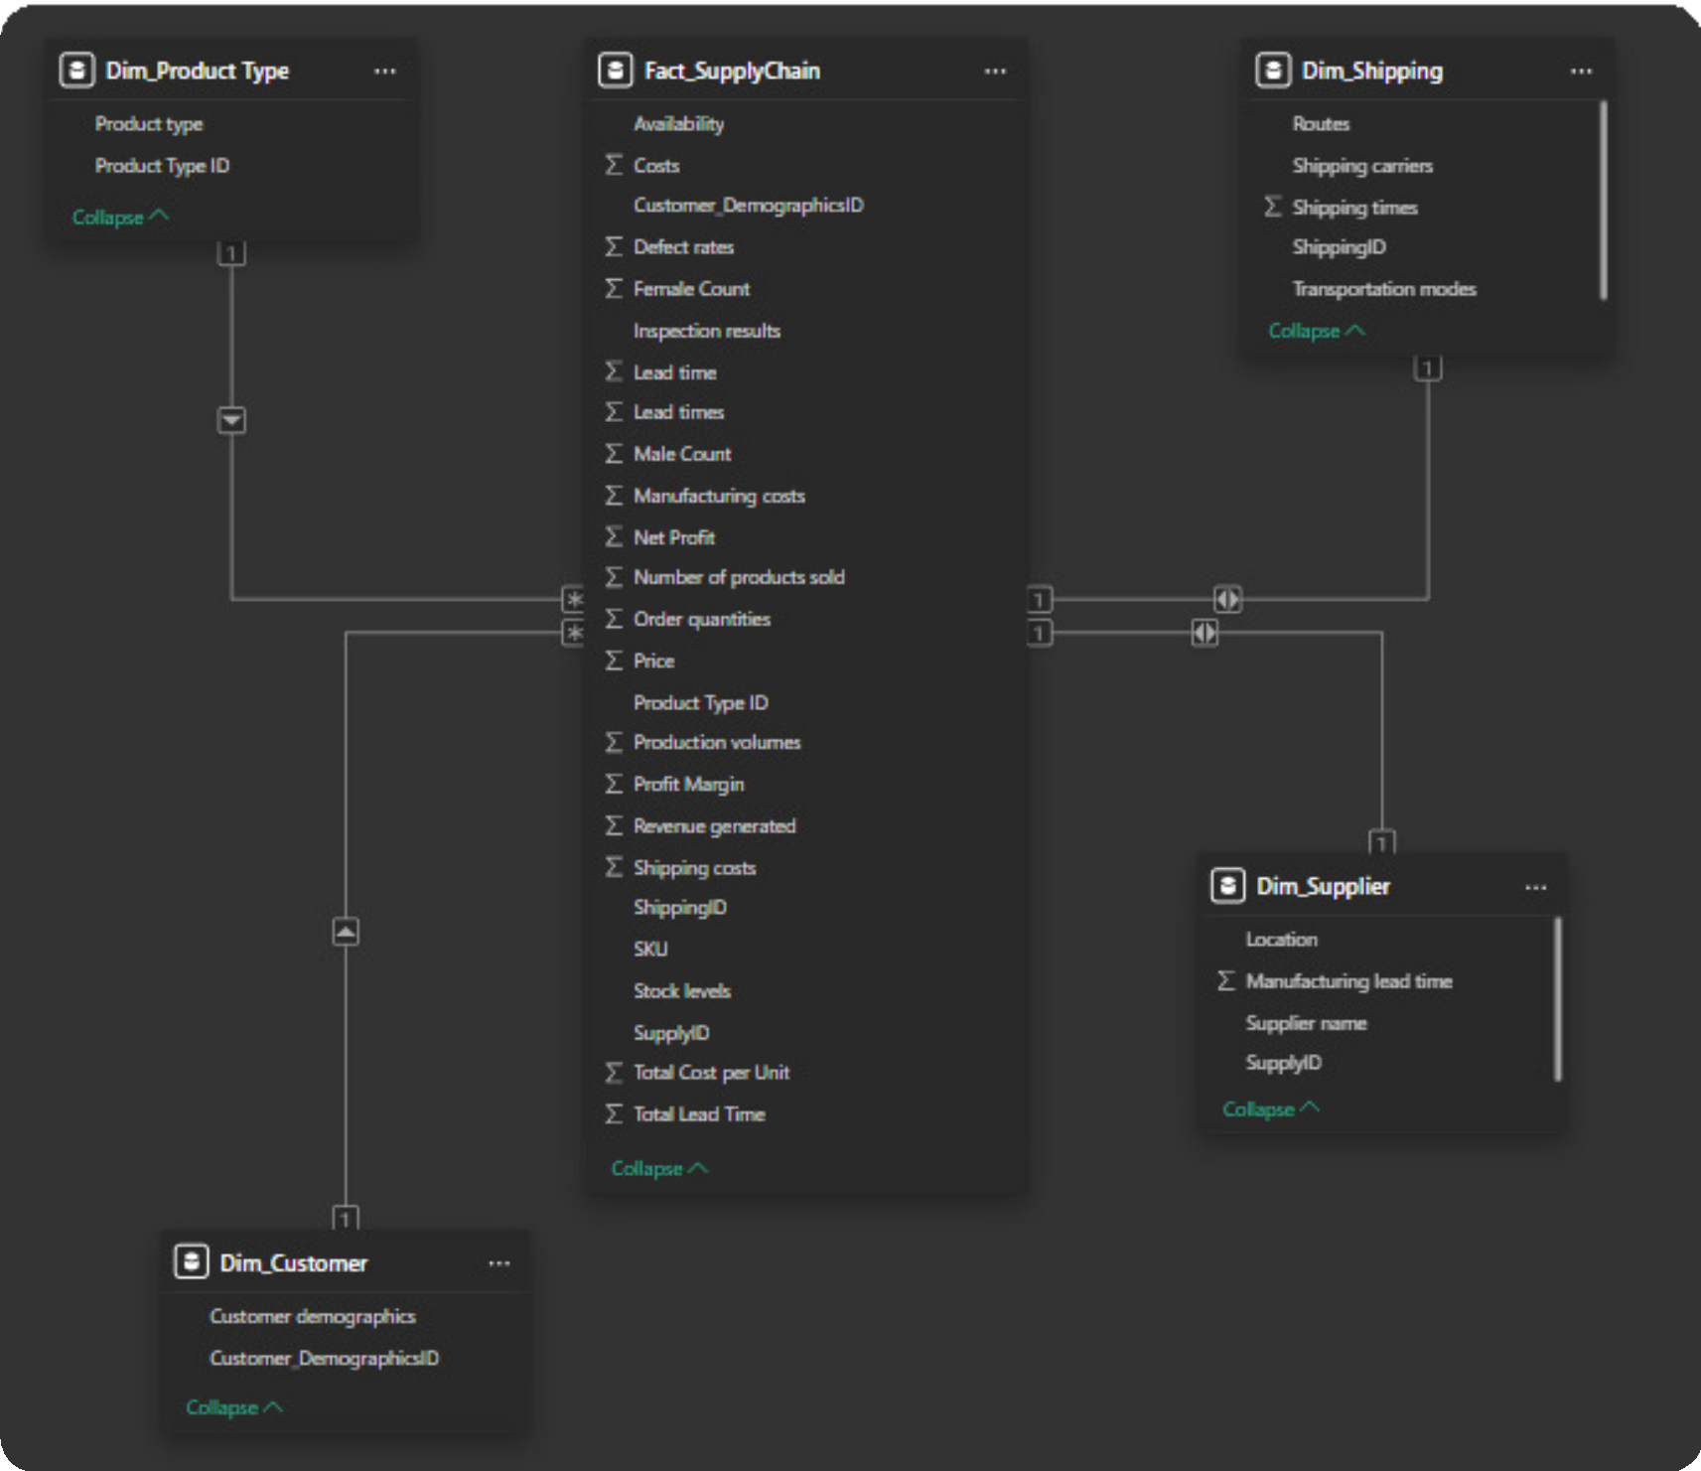
Data
Modeling

Slide 11
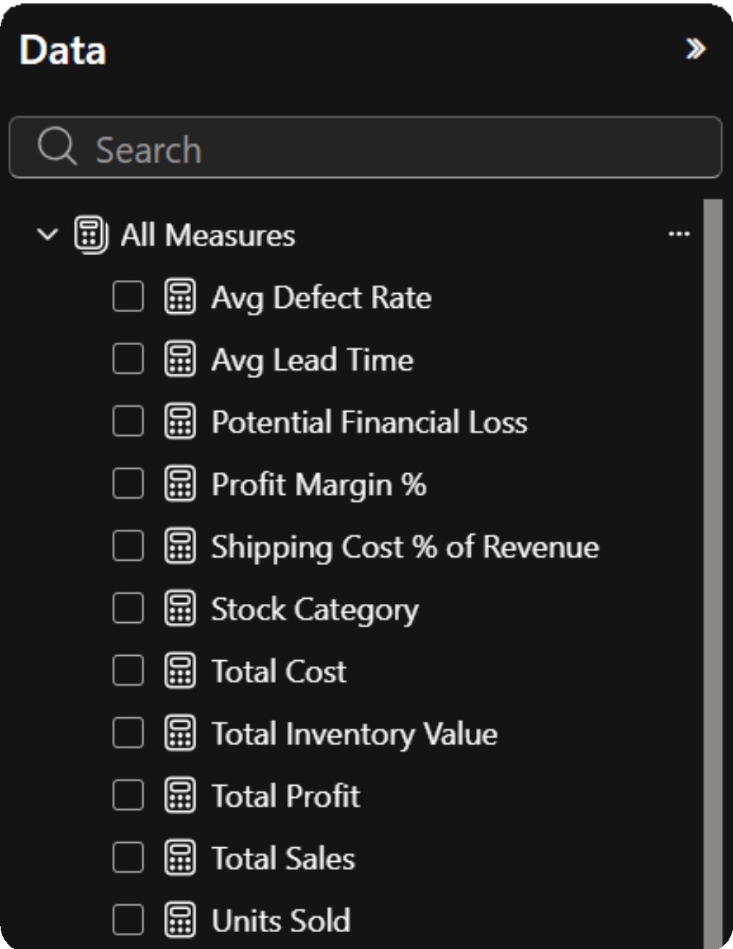
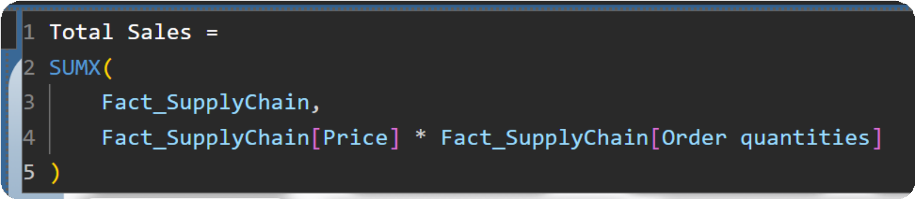
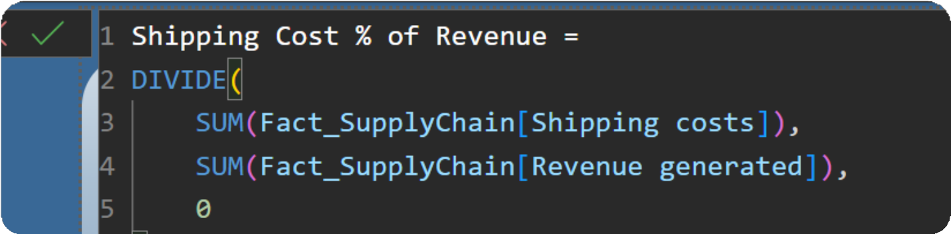
DAX Calculations

Slide 12
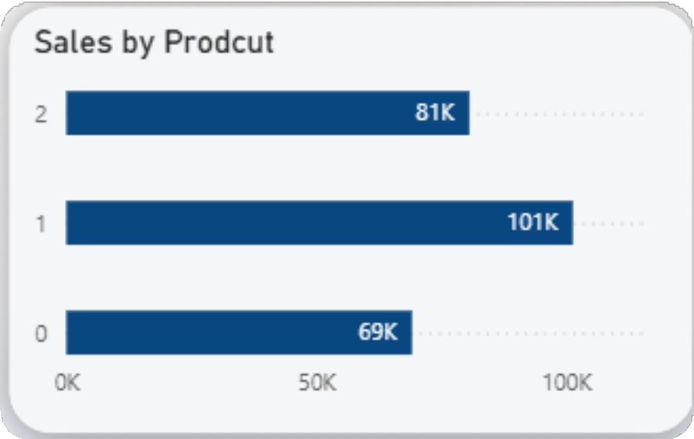
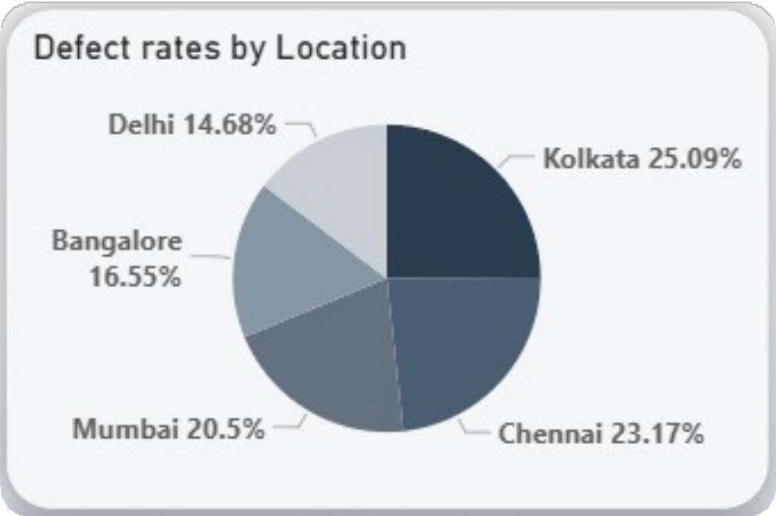
Sample Visual
The classic Bar Chart uses horizontal or vertical bars.
Columns to show discrete, numerical comparisons across categories.
Pie chart are ideal for giving the reader a quick idea of the proportional distribution of the data.
It clearly display percentage values and show the share of each segment in relation to the whole.

Slide 13
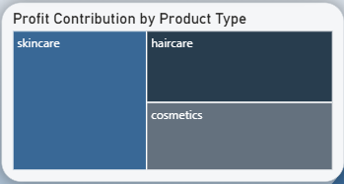
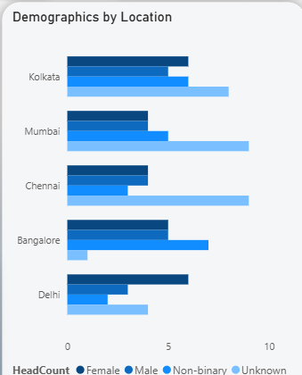
Sample Visual
Tree maps are used to visualize hierarchical structure while also displaying quantities for each category via area size, Each category is assigned a rectangle area with their subcategory rectangles nested inside of it.
A multi-series bar chart is a graphical representation that displays multiple sets of data (series) using bars. Each series is represented by bars grouped together for comparison across different categories.

Slide 14
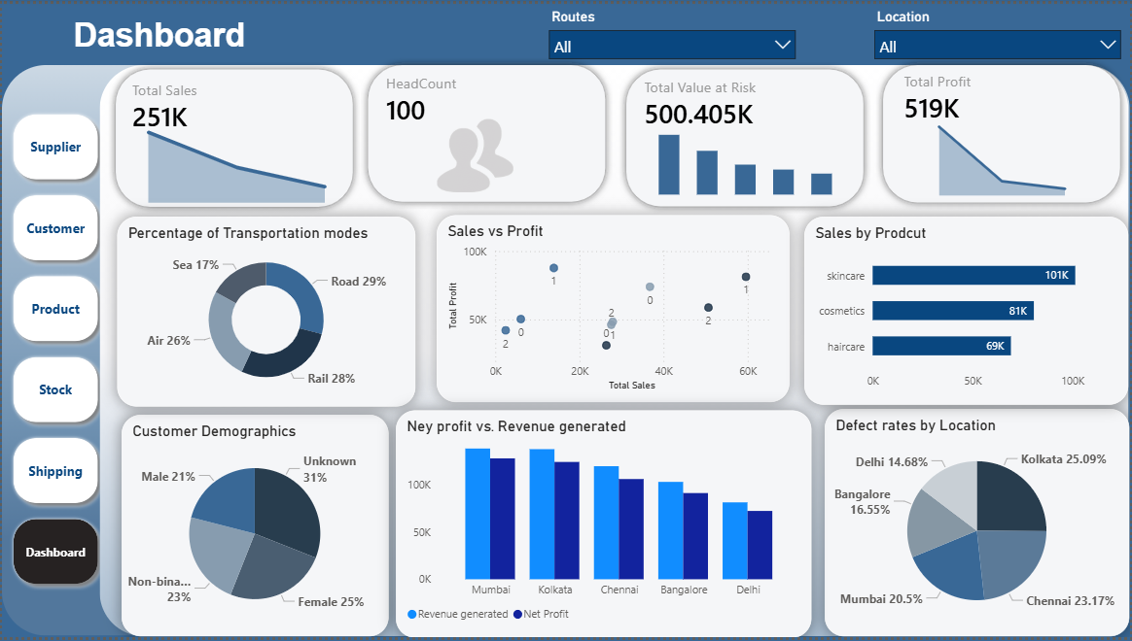
Dashboard

Slide 15
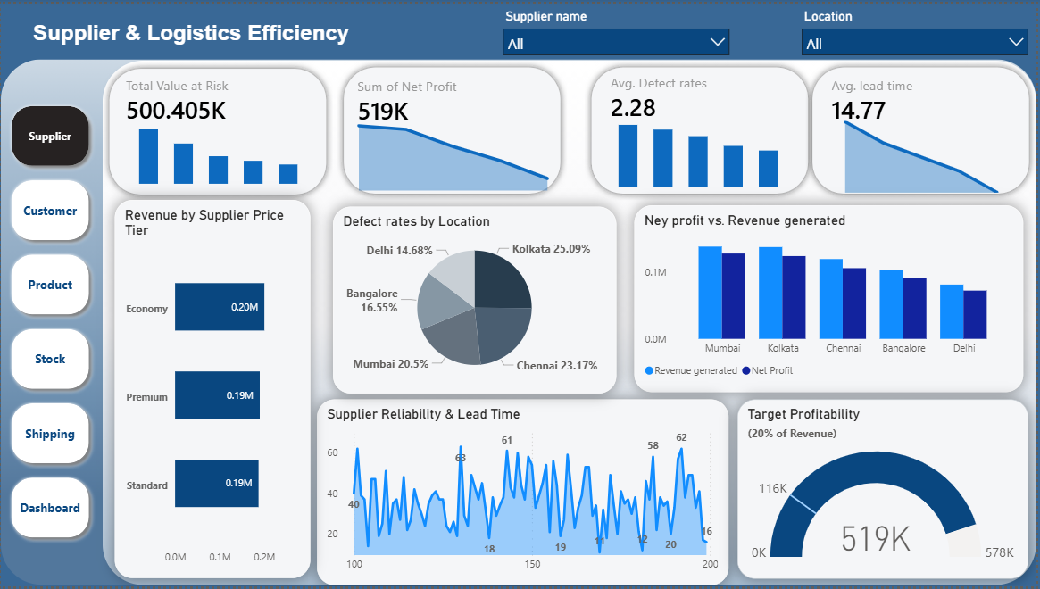
Supplier & Logistics Efficiency

Slide 16
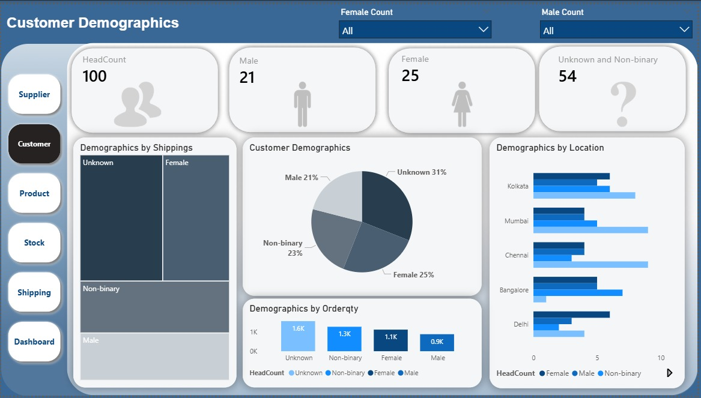
Customer Demographics

Slide 17
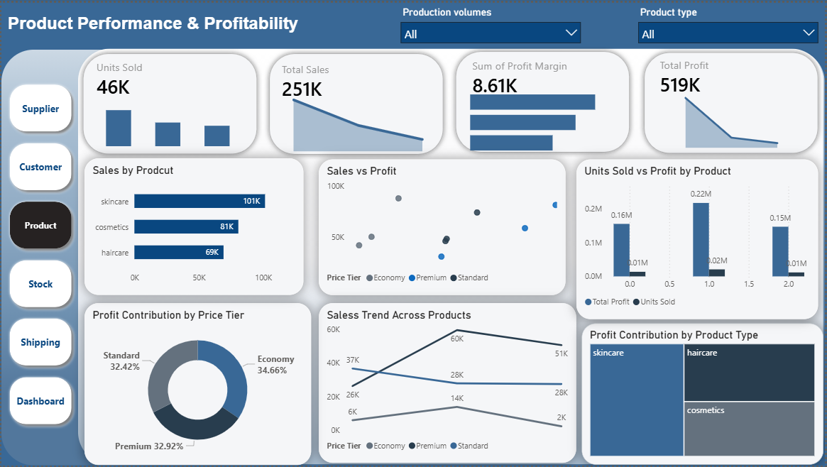
Product Performance & Profitability

Slide 18
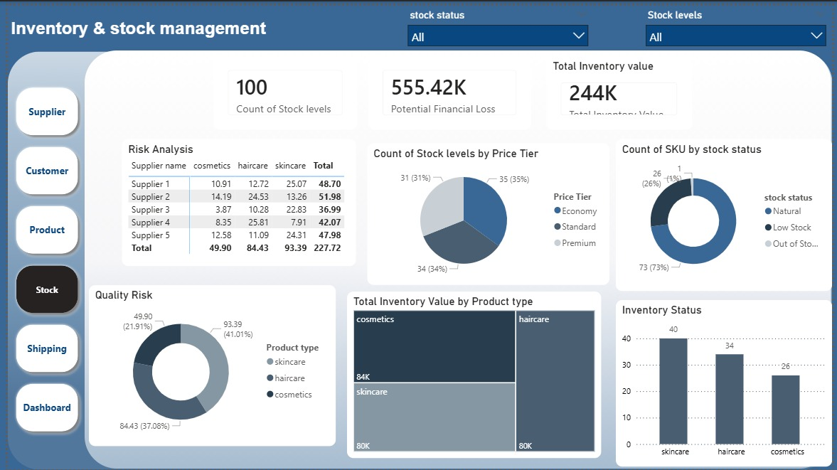
Inventory & Stock Management

Slide 19
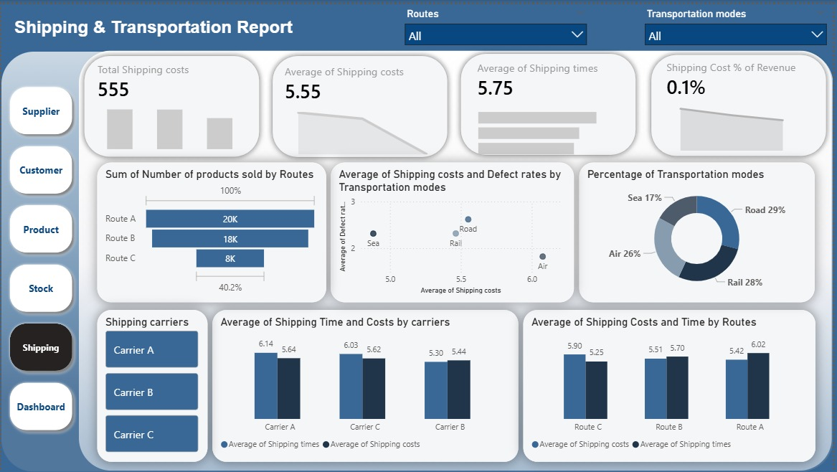
Shipping & Transportation Analysis

Slide 20
Insights
Profitability Insights
Supplier Insights
A small group of products contributes to the majority of profit (Pareto effect)
Some high-sales products have low profitability, indicating pricing or cost issues
Certain suppliers consistently cause delays, impacting delivery performance
Cost differences between suppliers significantly affect margins
Customer Insights
A few customer segments drive most revenue Clear seasonal or trend-based purchasing patterns Geographic concentration of high-value customers
Inventory Insights
Overstocking exists in slow-moving products → ties up capital
Fast-moving products face stockout risks, affecting sales
Shipping Insights
Specific regions show longer delivery times Faster shipping methods increase cost but improve customer satisfaction

Slide 21
THANK YOU

